Slide 1

VCODEZ
PROJECT PPT

Slide 2
PROJECT TITLE
MEDICINE MANUFACTURING ANALYTICS AND WASTE REVENUE ESTIMATOR

Slide 3
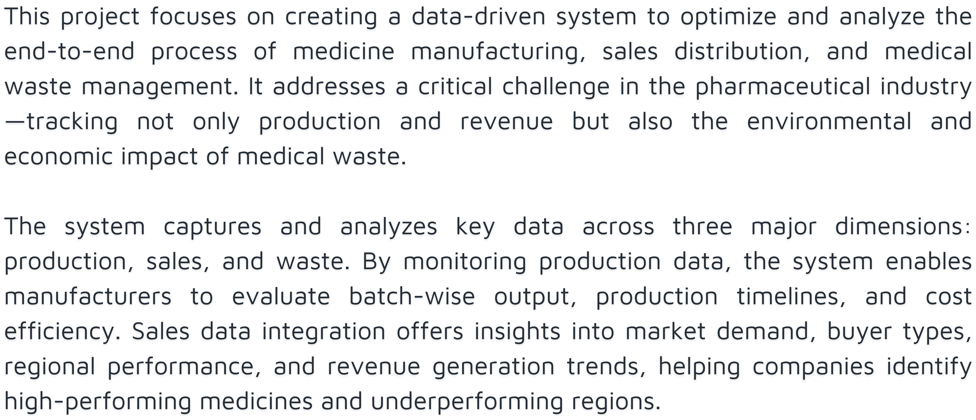
DESCRIPTION

Slide 4
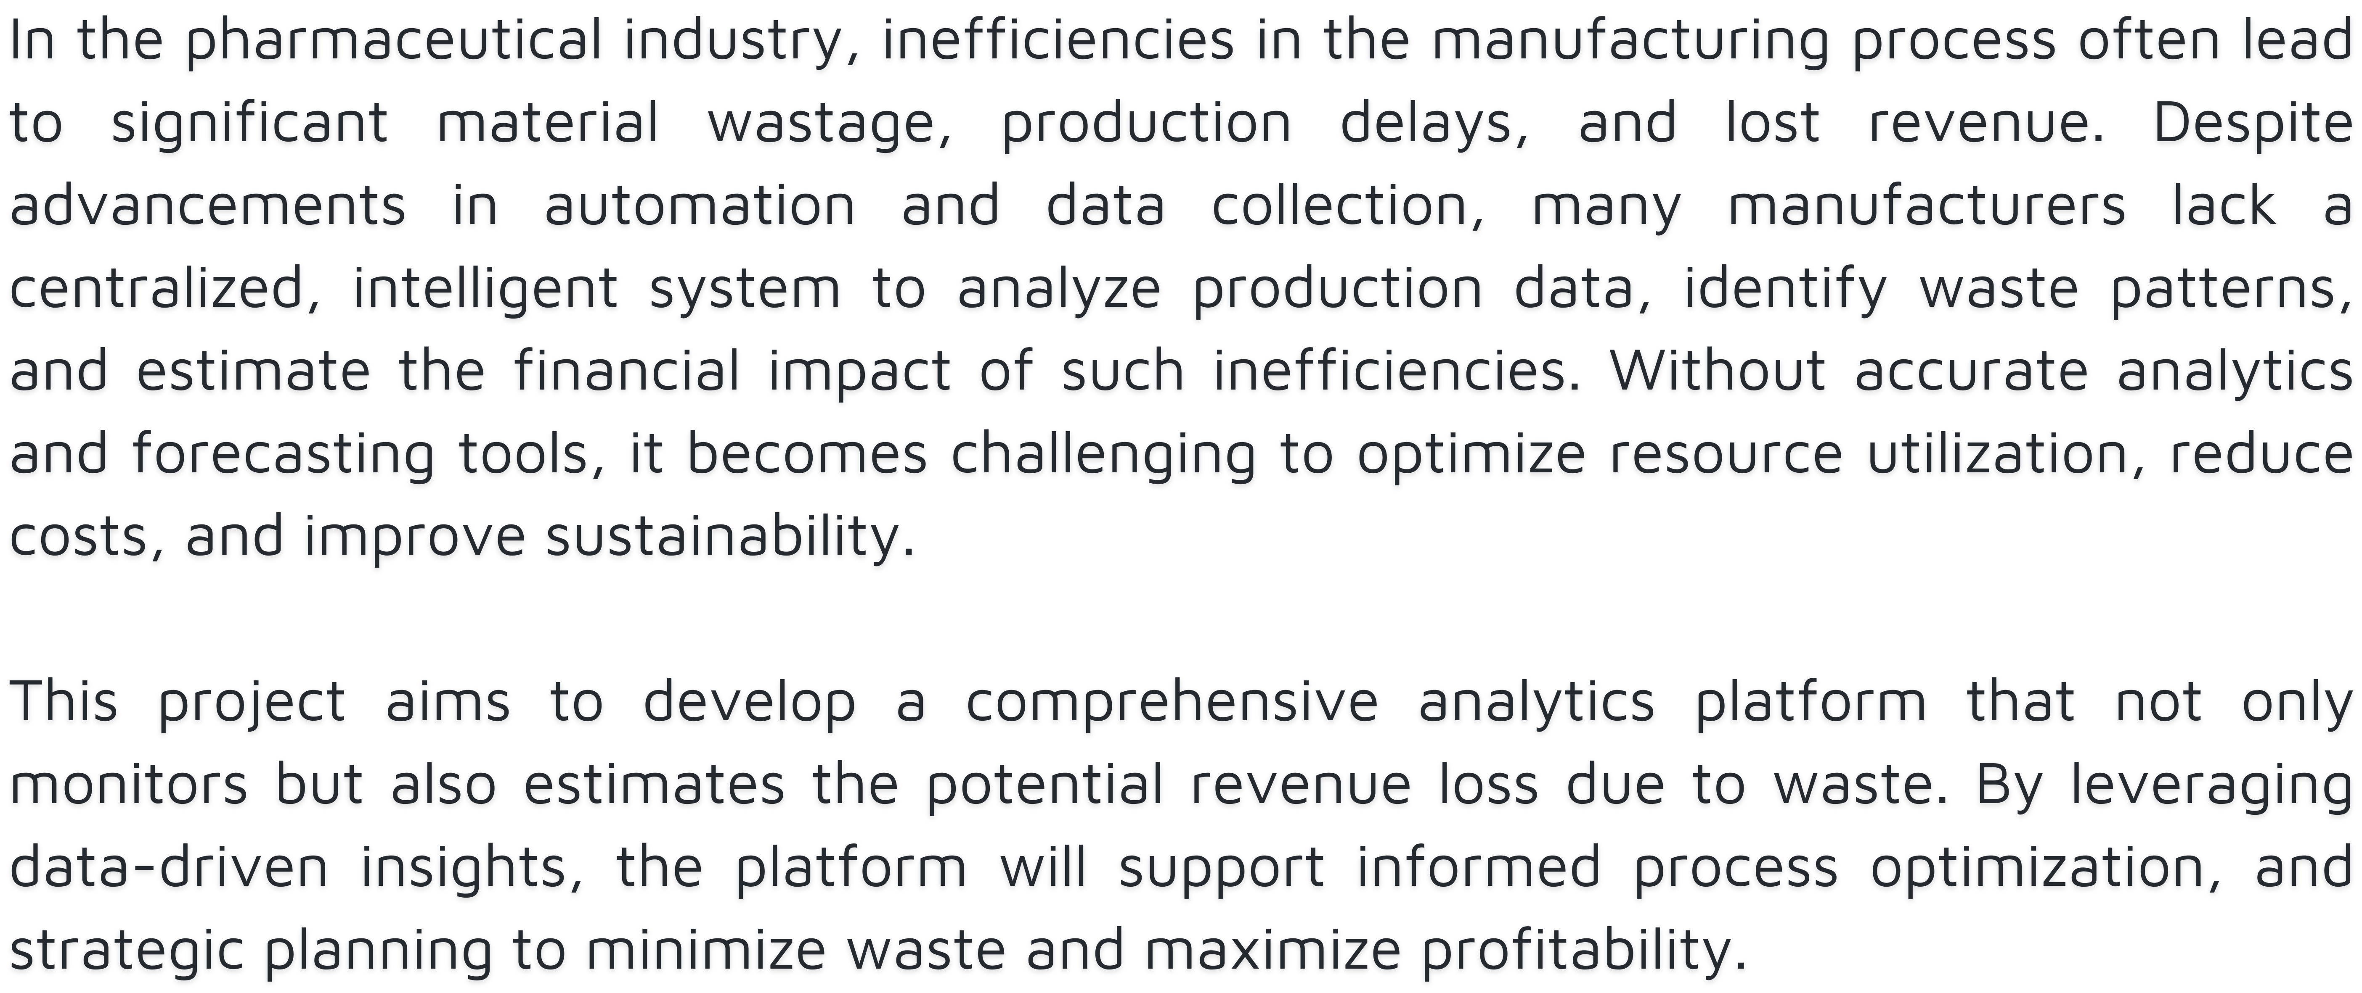
PROBLEM STATEMENT

Slide 5
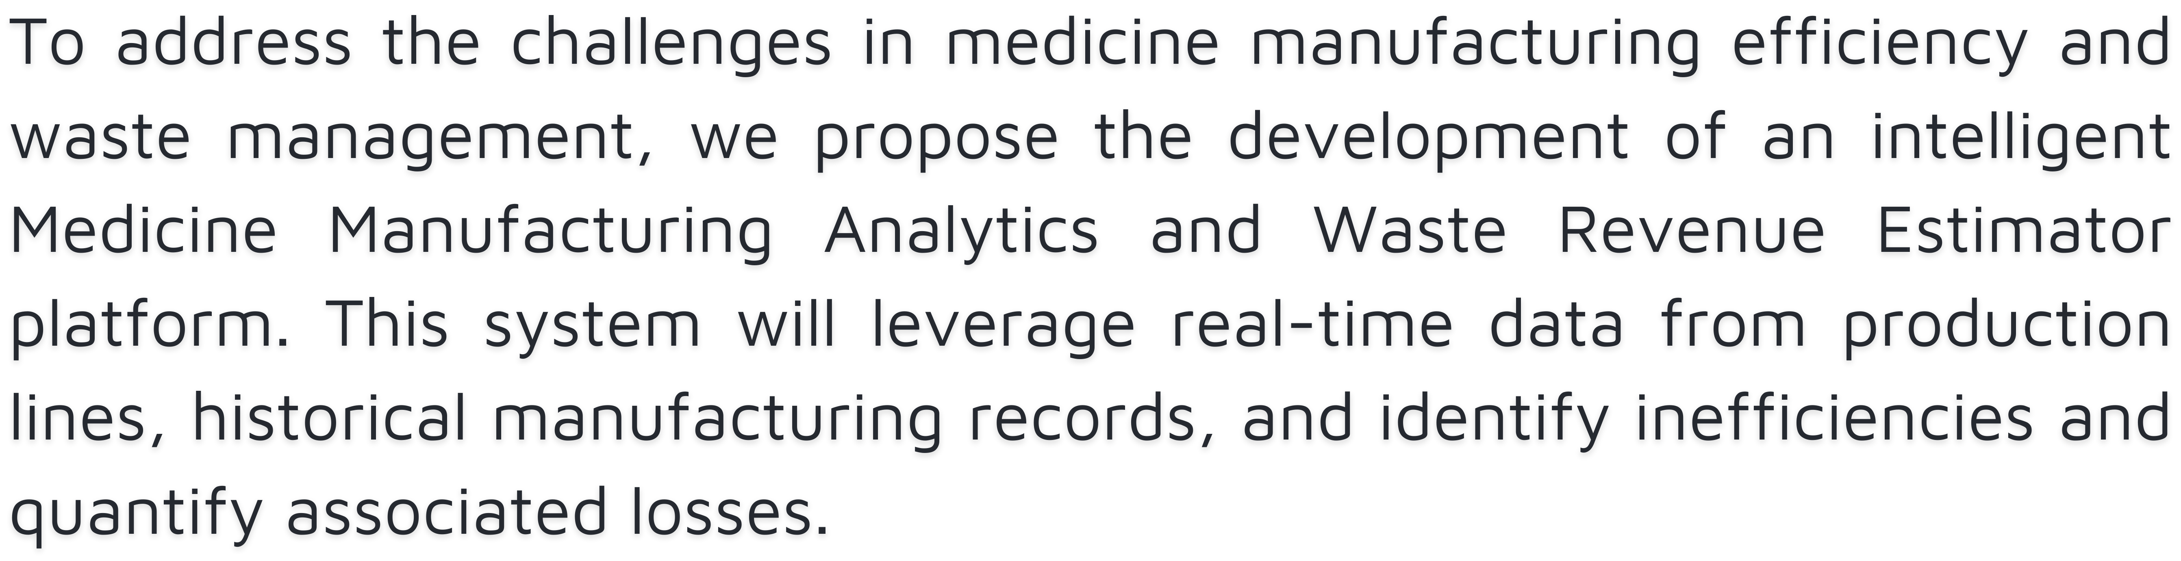
PROBLEM SOLUTION

Slide 6
EXISISTING SOLUTION
Several pharmaceutical companies and industrial technology providers have already implemented systems to improve efficiency and reduce waste in manufacturing
Such AS -
Manufacturing Execution Systems (MES) Enterprise Resource Planning (ERP) Systems Data Analytics Platforms for Manufacturing

Slide 7
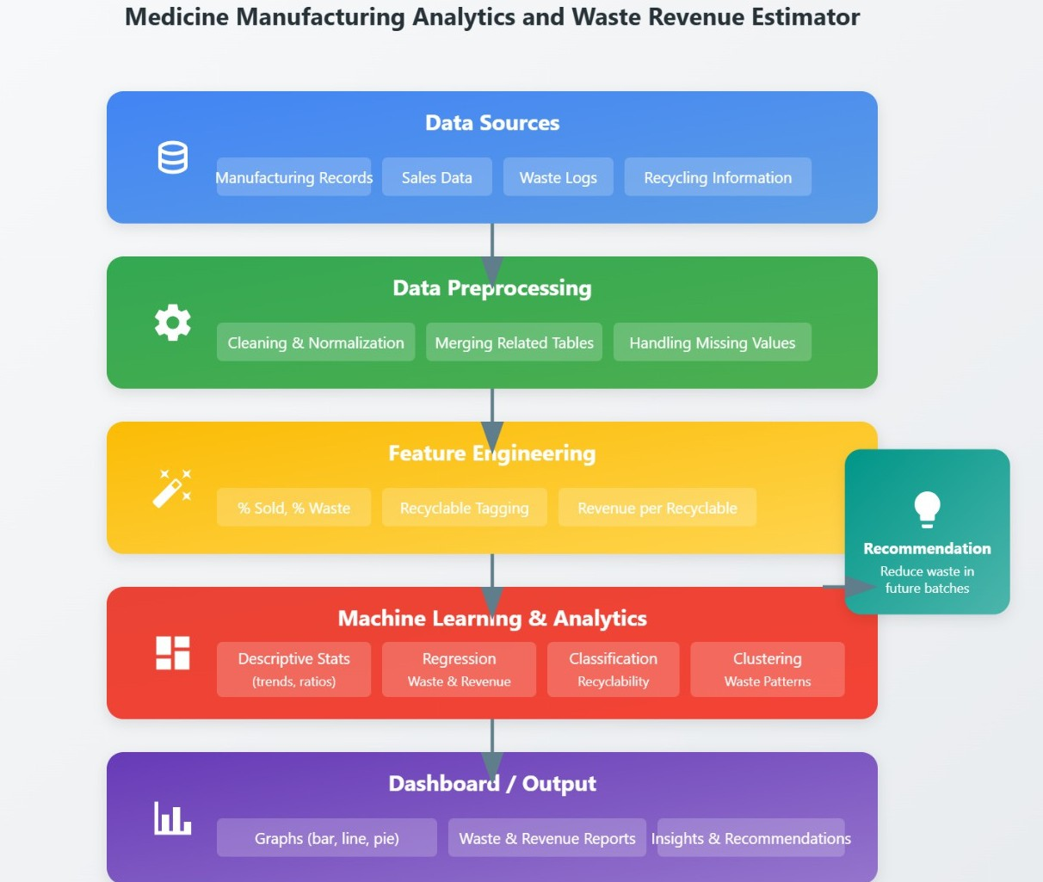
A
R
C
H
I
T
U
R
E

Slide 8
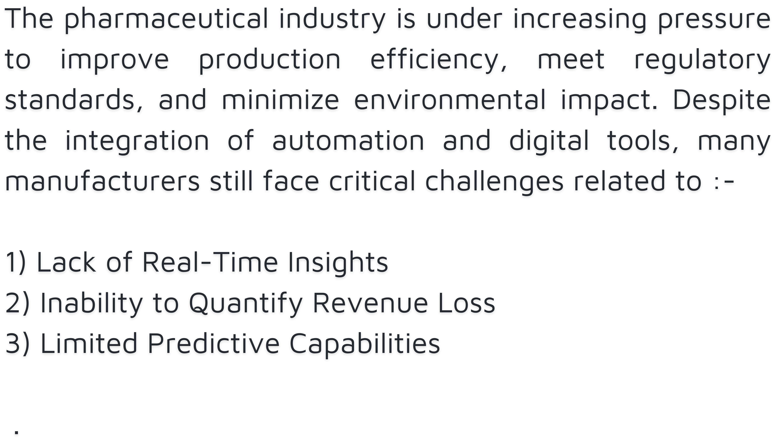
PROBLEM EVALUATION

Slide 9
SOFTWARE AND
HARDWARE INTERACTION
Software
Python
Pandas, Numpy
Matplotlib, Seaborn
Scikit-Learn
Joblib
Jupyter Notebook
CSV Files
Hardware
Barcode/RFID Scanner
Manufacturing Machines
Sensors (Optional IOT)
Industrial PC Or Edge Device
Cloud Server (Optional)

Slide 10
RESULT
10
Improved Operational Efficiency
Cost Savings
Revenue Loss Estimation
Optimized Resource Utilization
Better Quality Control
8
6
4
2
0
Item 1
Item 2
Item 3

Slide 11
Thank You

